Slide 1

Personalized MOOC Recommendations MOOCRec v2
MOOCs, chosen just for you.

Slide 2
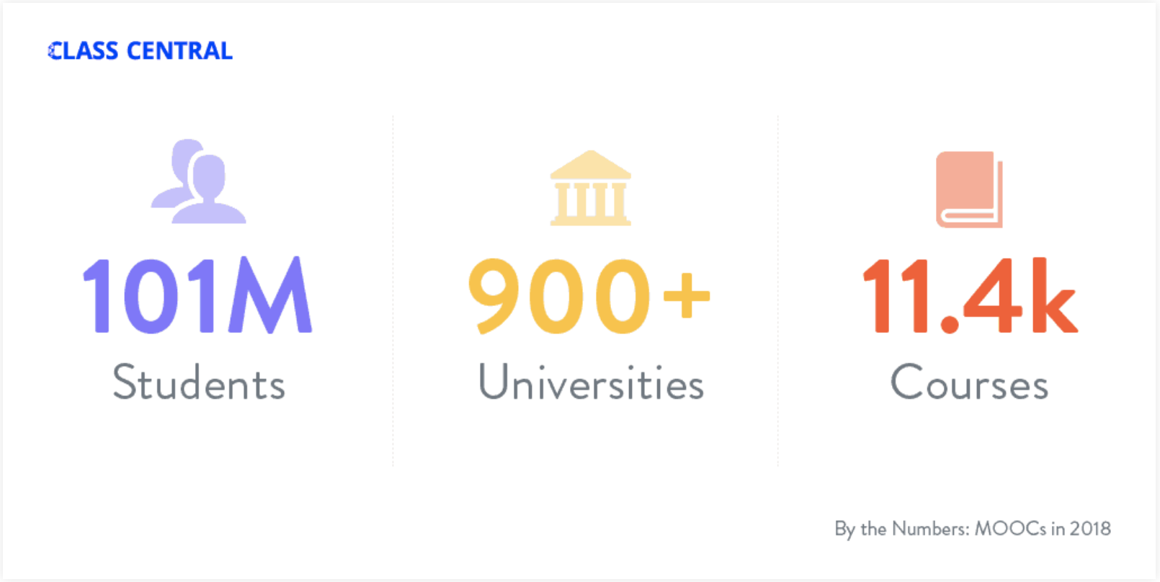
AN Overview of MOOCS
Source:
https://www.class-central.com/report/moocs-stats-and-trends-2018/
Figure 1: MOOCs Statistics from Class Central

Slide 3

Problem
MOOCs have different video production styles
MOOCs have a low completion rate
Consumers prefer different types of video production styles
Lack of connection between MOOC recommenders’ and consumers’ preference for video production styles
No personalization exists for MOOC recommendations

Slide 4

Solution
Your personalized MOOC Recommender

Slide 5
features
Identifying your preferred video styles for learning.
Identify all prominent video styles in e-learning courses.
Automatically analyzing forum discussions to provide popular online courses.
Identifying user’s learning style based on their preferences.

Slide 6
Conclusion
Matches the user with the type of learning that he/she requires.

Slide 7
Thank you

Slide 9
General objectives
Identifying user's learning preferences by a more interactive method
Implement support for parallel processing to significantly improve performance
Improve MOOC recommendations based on information within discussion forums
Add support for categorizing newer & more complex video styles

Slide 10
specific objectives
Hub for MOOCs
A catalogue of MOOCs from most popular providers
Forum activity across platforms are analyzed automatically
Personalized MOOCs
Provide MOOCs that match the consumers' preferences
Use the sentiments of other users
Image Classification
Accurately classify a wide range of video production styles
Efficiently classify using parallel processing

Slide 11
MOOCREC v1 Drawbacks
A solution proposed by a previous research
Proposed solution, MOOCRec V2 extends up on MOOCRec V1
Identifies learner styles using a lengthy questioner
Covers only a few video production styles
Inefficient video classification

Slide 12
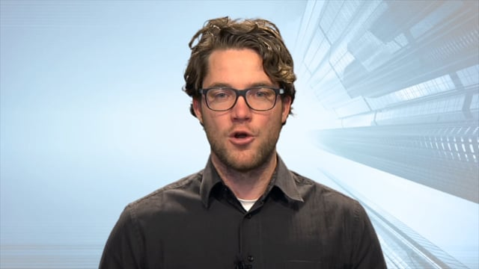
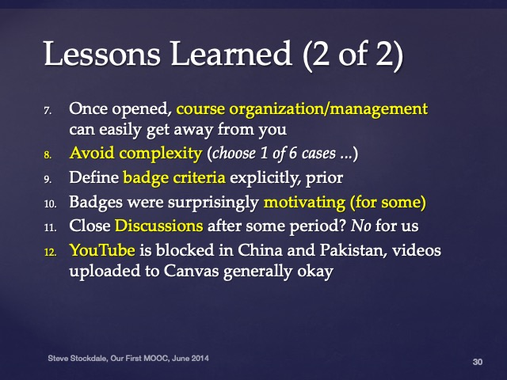

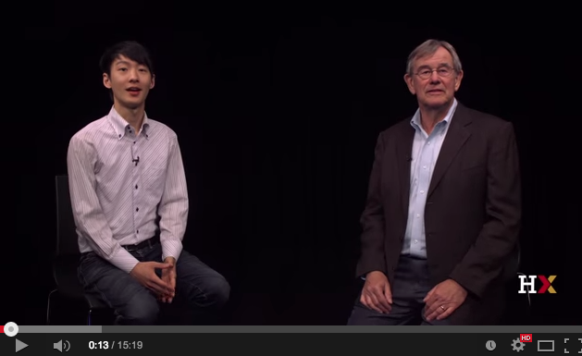
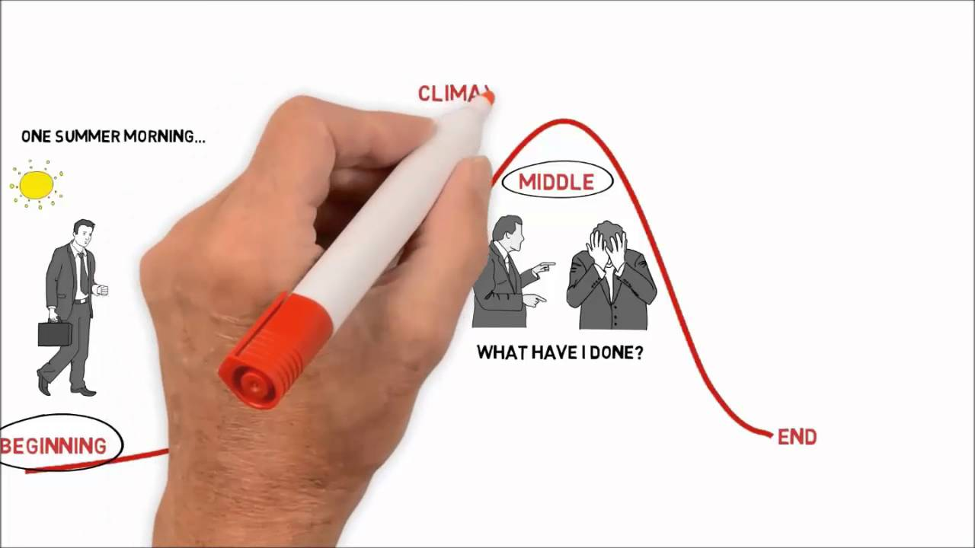
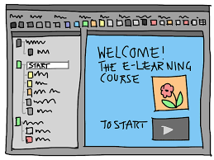

Complex Video production style classification
Different types of MOOC video production styles
Talking Head
Presentation slides with voiceover
Coding/Demonstration
Conversations
Writing
Animation

Slide 13
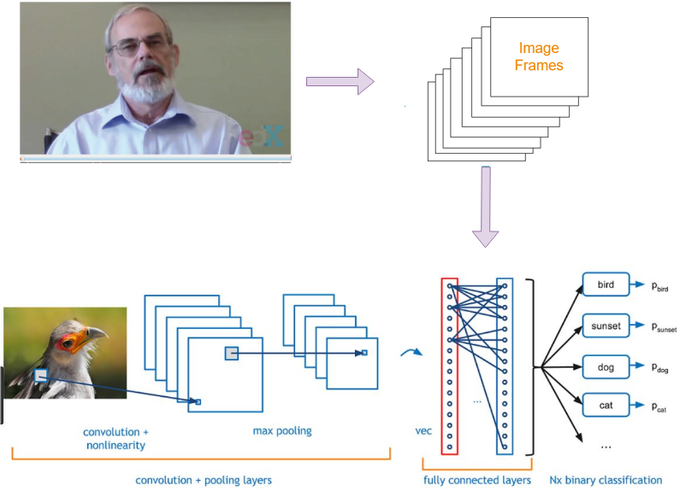
Complex Video production style classification
Figure 3 : Video Classification

Slide 14

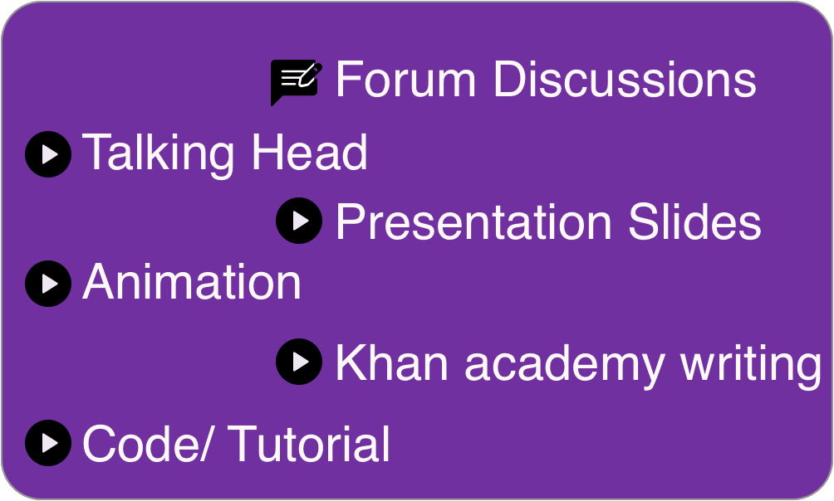
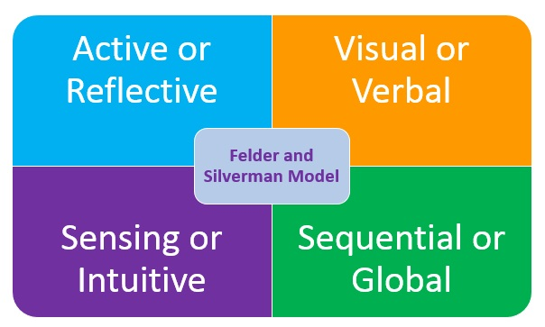

Identifying user’s preferred learning style
Identified using an interactive introductory video
Intro video contains MOOCs learning material types recognized by MOOCRec V2
Learning material types and Felder Silverman Learning Style Model are mapped
Mapping is introduced based on literature survey
Figure 6: Learning Material Type to FSLSM Mapping

Slide 15


Identifying user’s preferred learning style Procedure
Watch the interactive segment
Provide your feedback on the learning experience
Video style preference
MOOCRec V2 Video style extraction algortihm
MOOCRec V2 Video style to learning style mapping algortihm
User's learning style
Figure 9 : Procedure of identifying User’s Preferred Learning Material

